Slide 1
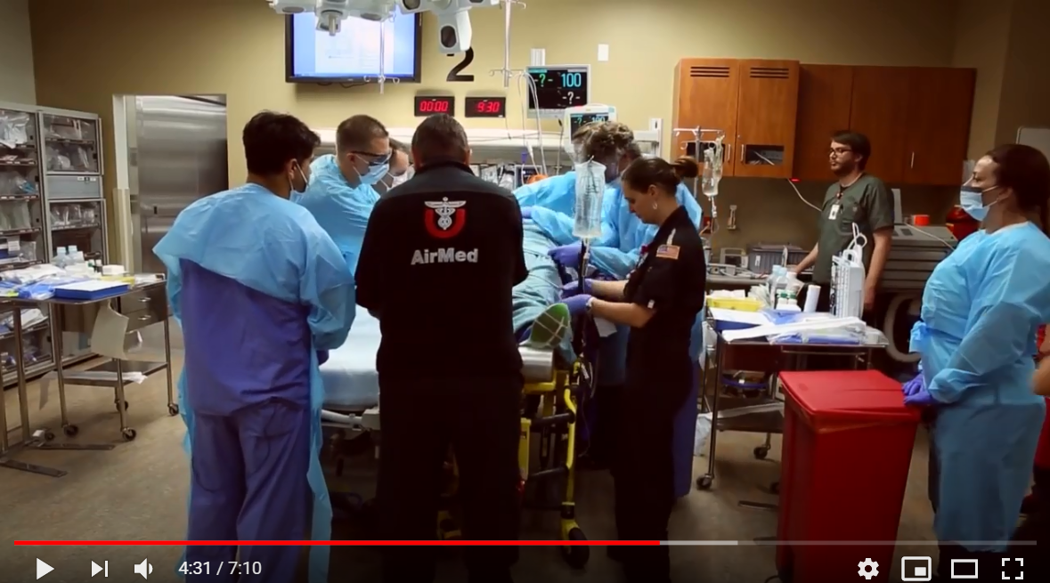
Final Project
Detect the faces with mask/heads in videos

Slide 2
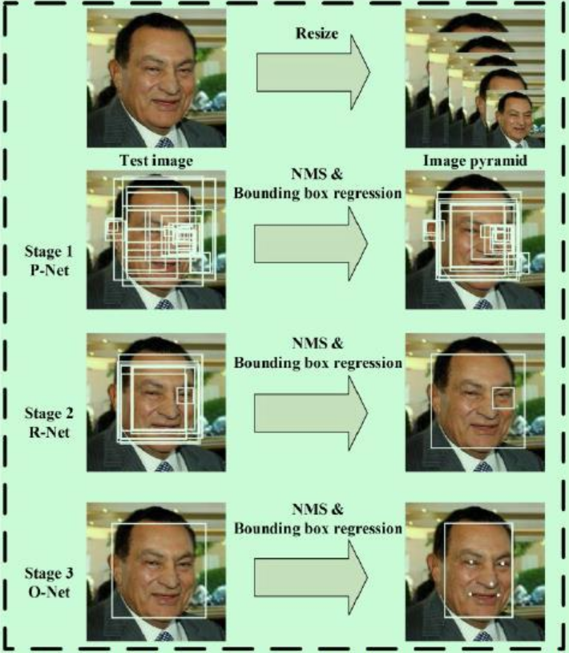
Algrithom:MTCNN
MTCNN (Multi-task Cascaded Convolutional Networks) algorithm is used to achieve face detection and alignment at the same time.
Three Sub-networks:
Proposal Network (P-Net)
Refine Network (R-Net)
Output Network (O-Net)
Coarse-to-fine algrithom

Slide 3
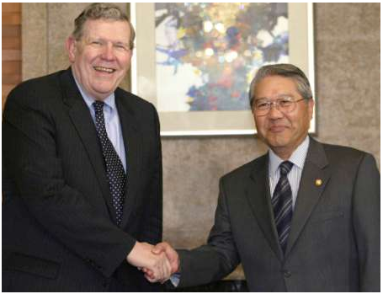
Example
Input picture

Slide 4
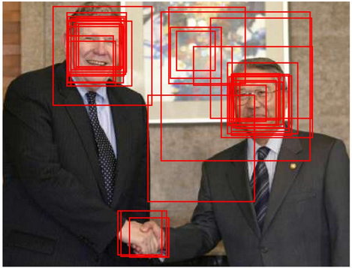
P-Net is used to generate some candidate bounding boxes.
Resample the original image to obtain a series of images with different size to be detected.
Input these images into PNet will output a series of bounding boxes, remove those boxes whose scores do not meet the standard

Slide 5
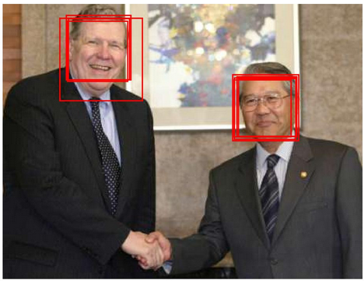
R-Net is mainly used to remove most non-face frames.
Input: The box generated in the first stage intercepts the corresponding area in the original image
Output: For each input box, output the corresponding coordinate regression value and the corresponding score of the face. Remove the boxes that don't reach the standard, and get the box collection of the second stage.

Slide 6

O-Net is used to output the final face bounding boxes.

Slide 7
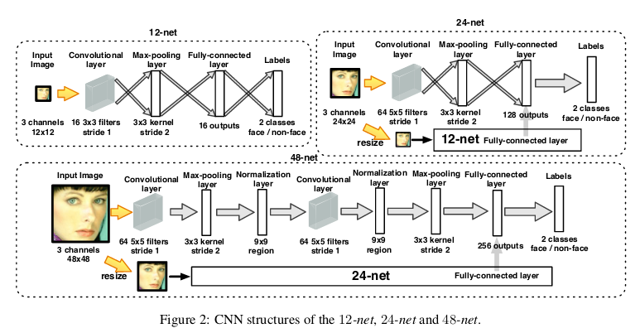
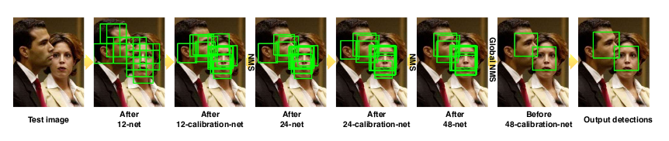
MTCNN

Slide 8
Main Libraries
Cuda
Cudnn
Mtcnn
Tensorflow/Caffe
OpenCV

Slide 9
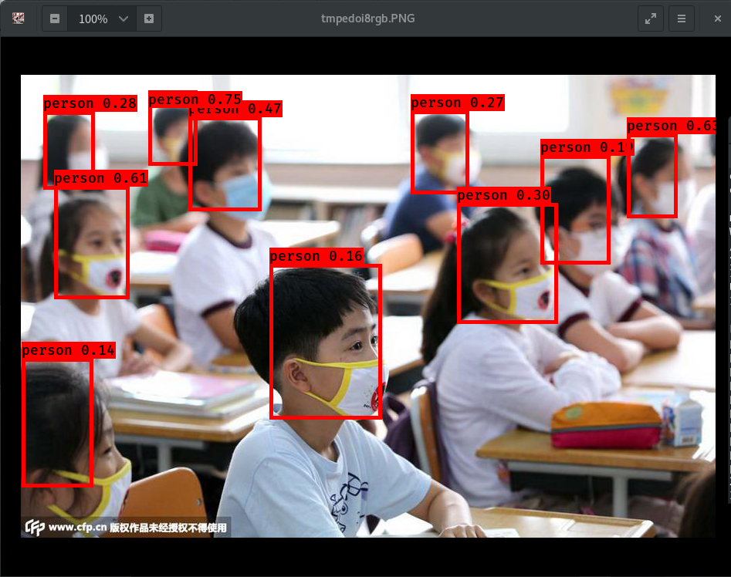
Results

Slide 10
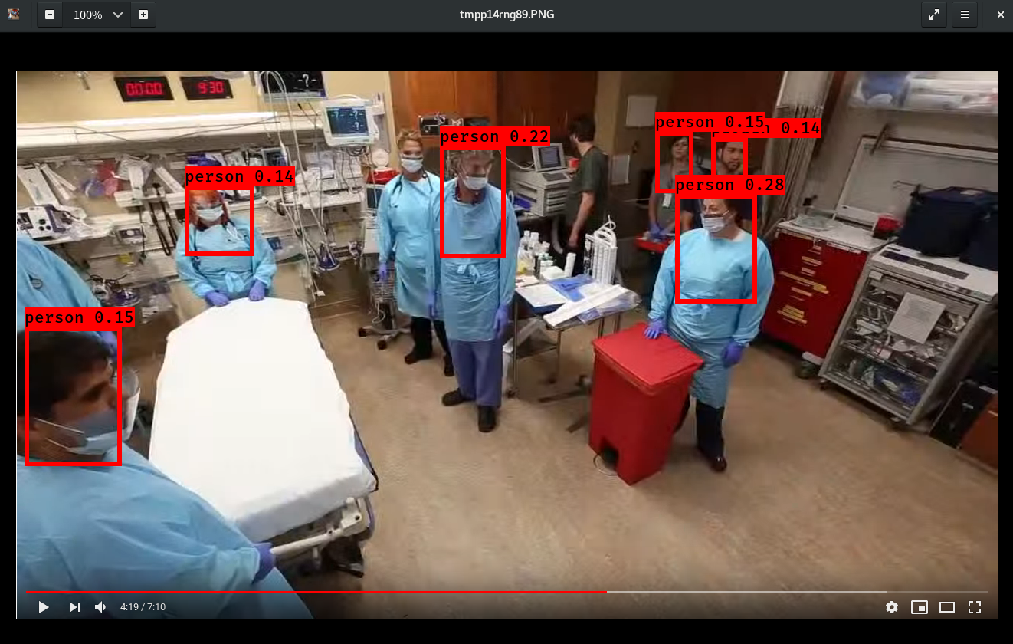
Results

Slide 11
Demo
Thanks

